Slide 1
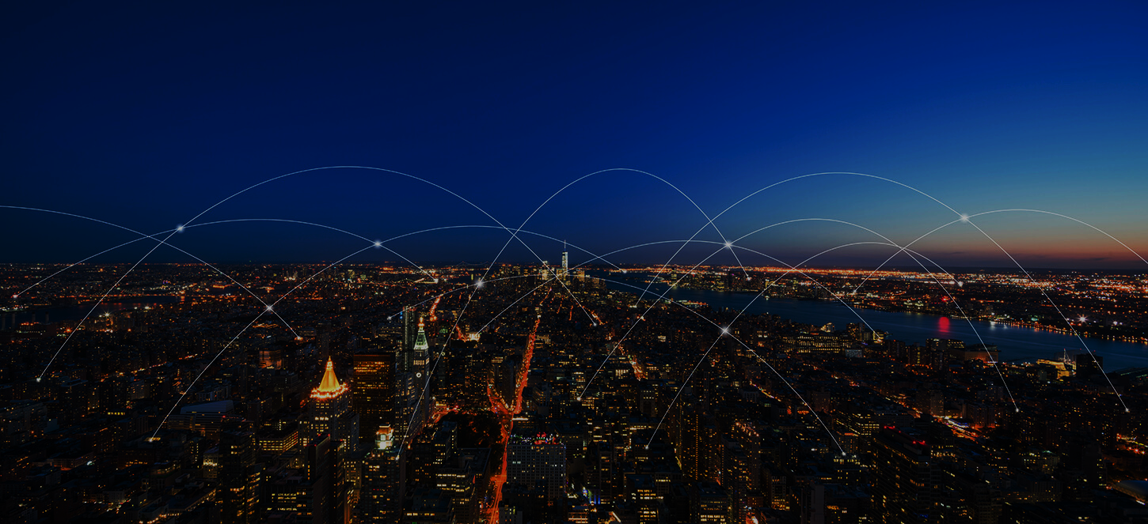
SMART CITY
Assignment for Sabyasachi B
By:
Harish H
Supriya M.K
Gourav P
Sanjay
Guided By:
Mohammad Tahir Mirji

Slide 2
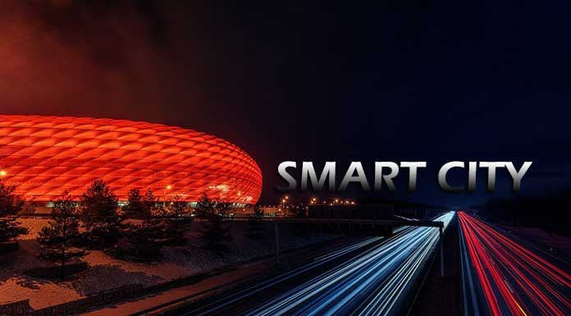
Introduction
Smart City:
A smart city is an urban area that utilizes technology and data-driven solutions to enhance the quality of life for its residents, improve the efficiency of services, and create a sustainable and inclusive environment.

Slide 3
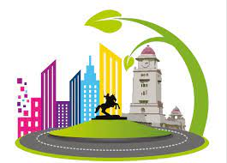
HUBLI Dharwad SMART CITY
Hubli-Dharwad is a twin city located in the state of Karnataka, India. It is the second-largest city in Karnataka after Bangalore and forms a single municipal corporation known as theHubli-Dharwad Municipal Corporation (HDMC). The city is a major commercial and industrial hub in the region.

Slide 4
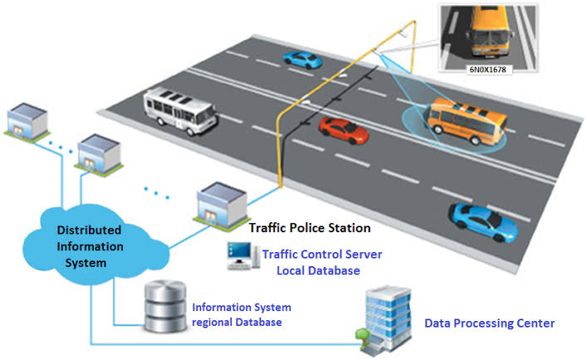
Importance of technology and implementation initiative in Hubli – Dharwad
Smart Traffic Management System: One significant implementation in Hubli-Dharwad is the Smart Traffic Management System. The city has adopted advanced technologies to address traffic congestion and improve the overall traffic management system.
Implementation
Hubli-Dharwad has deployed a network of intelligent traffic signals equipped with sensors and adaptive control mechanisms. These signals adjust dynamically based on traffic patterns, ensuring efficient traffic flow. Additionally, the city has implemented a centralized command and control center that receives real-time data from traffic cameras, sensors, and other sources. The data is analyzed to gain insights into traffic patterns, which helps in making informed decisions for traffic management and optimization.

Slide 5
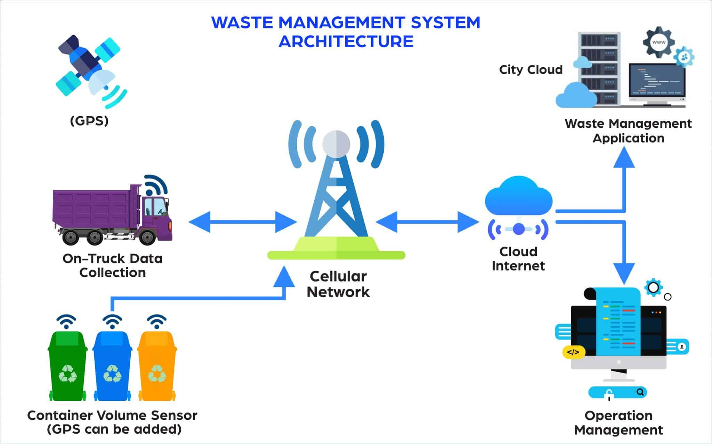
Smart Waste Management System:
Hubli-Dharwad has implemented a smart waste management system using technology to improve waste collection, disposal, and recycling processes.
Efficient Waste Collection:
The smart waste management system uses sensors and IoT technology to monitor waste levels in bins. This allows waste management authorities to optimize collection routes, ensuring timely and efficient waste collection and reducing overflowing bins.

Slide 6
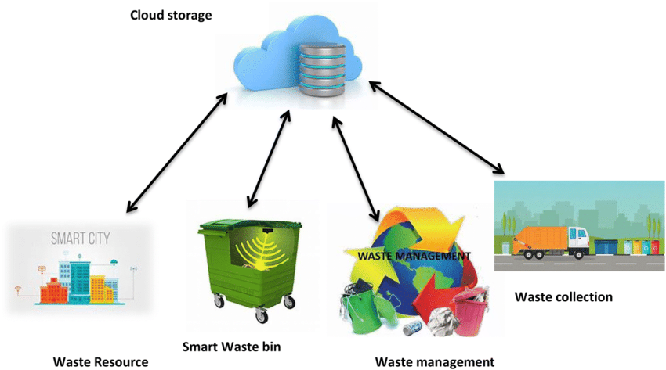
Implementation:
In Hubli-Dharwad, smart waste bins equipped with sensors have been deployed across the city. These sensors detect the fill levels of the bins in real-time and transmit the data to waste management authorities. Based on this data, authorities can efficiently plan waste collection routes, ensuring that bins are emptied before reaching capacity. The system also enables monitoring and tracking of waste collection vehicles, further optimizing their operations.
The implementation of the smart waste management system in Hubli-Dharwad showcases the importance of technology in improving waste management processes, reducing environmental impact, and promoting sustainable practices in the city.

Slide 7
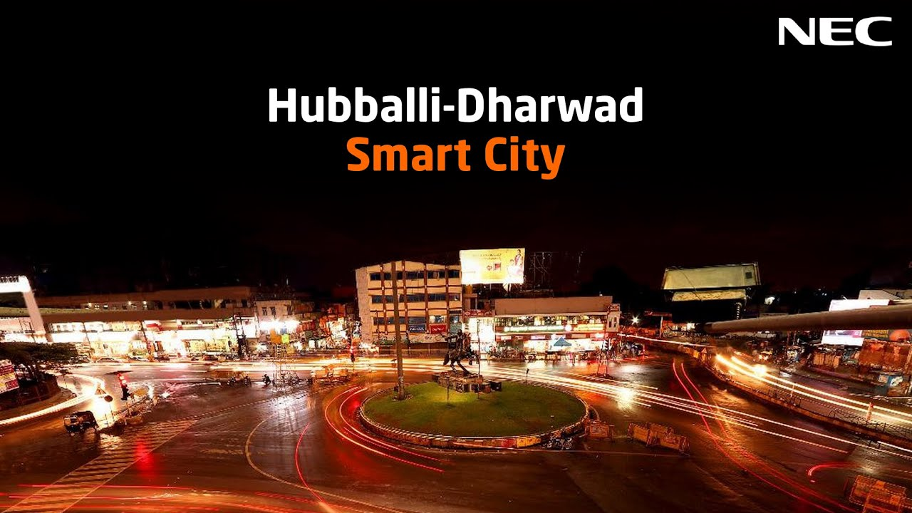
Key points should be considered in implementation of smart city in hubli- dharwad
☞ Smart City Initiative
☞ Area and Population
☞ Infrastructure Development
☞ Technology Integration
☞ Citizen Engagement
Green Initiatives
Economic Growth
☞ Education and Healthcare
☞ Tourism and Culture

Slide 8
Smart City Initiative
Hubli-Dharwad was selected under the Smart Cities Mission by the Government of India in the year 2016. The mission aims to promote sustainable and inclusive development in cities across the country.
Area and Population
The combined area of Hubli-Dharwad is approximately 200 square kilometers, and the estimated population is around 1.5 million people.

Slide 9
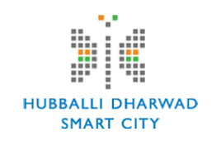
Infrastructure Development:
As part of the Smart Cities Mission, Hubli-Dharwad has been focusing on the development of various infrastructure projects. These include the improvement of road networks, transportation systems, water supply, sanitation, solid waste management, and urban housing.
Technology Integration:
The city has been working on integrating various technologies to enhance the quality of life for its residents. This includes the implementation of smart grids, intelligent transportation systems, e-governance platforms, and the use of information and communication technology (ICT) for better service delivery.

Slide 10
Citizen Engagement:
Hubli-Dharwad has been actively involving citizens in the decision-making process and encouraging their participation in the development of the city. The authorities have set up platforms for citizens to provide feedback, suggestions, and complaints, thus fostering a sense of ownership and transparency.
Green Initiatives:
The city has been promoting sustainable practices and green initiatives. This includes the development of green spaces, parks, and gardens, as well as the implementation of renewable energy projects and energy-efficient solutions.

Slide 11
Economic Growth:
Hubli-Dharwad has a diverse economic base, with industries such as engineering, manufacturing, textiles, agro-processing, and trade playing a significant role. The smart city initiatives aim to promote further economic growth and attract investments by providing a conducive business environment.
Education and Healthcare:
The city has a well-established education and healthcare sector. It is home to several educational institutions, including universities, colleges, and research centers. Hubli-Dharwad also has hospitals and medical facilities that cater to the healthcare needs of its residents.

Slide 12
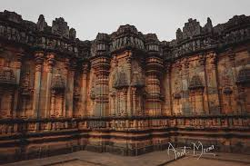
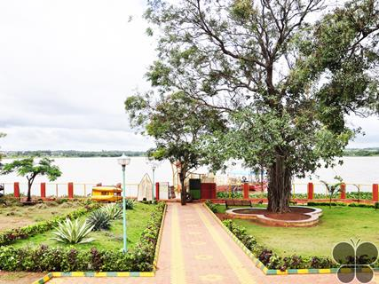
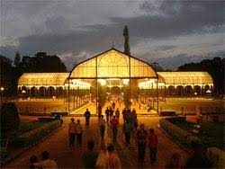
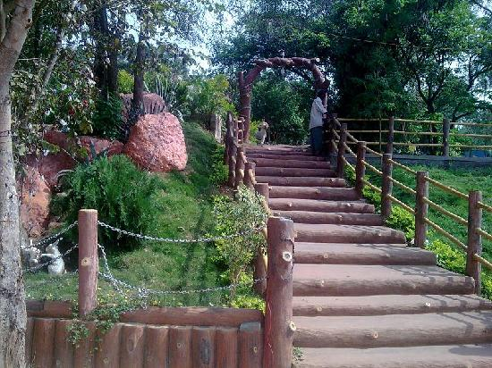
Tourism and Culture:
Hubli-Dharwad has a rich cultural heritage and is known for its historical and religious sites. The city attracts tourists with attractions like the Chandramouleshwara Temple, Nrupatunga Hill, Indira Gandhi Glass House Garden, and Unkal Lake.

Slide 13

video

Slide 14
Conclusions
The smart city initiative in Hubli-Dharwad is aimed at transforming the city into a sustainable, technologically advanced, and citizen-centric urban center. Through the implementation of various infrastructure projects, integration of technology, and citizen engagement, the city is working towards improving the quality of life for its residents and promoting economic growth

Slide 15
THANK Y☺U

